Slide 1

Angular
An Introduction
Chris carvalho

Slide 2

Today’s Menu
How can Angular help me?
What is Angular good at?
Important Angular Topics
Best Practices
What not to do
Where to learn more
Wow
Plus five quick demos (with code)!

Slide 3
How can Angular help me?
Model – View – Controller design
Easy code organization
Single responsibility principle
Single Page Application
Dynamic Views
Lower page load times
You don’t have to reload with every click
An extension of HTML and Javascript

Slide 4
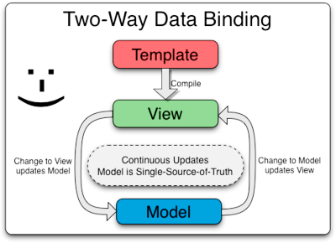
Angular is good at:
Controlling the UI
2-Way Data Binding
Automatic UI updates
Demo

Slide 5
Angular is good at:
Built-in UI tools for common tasks
ng-show
ng-click
ng-repeat
Demo

Slide 6
Angular is good at:
Http calls & Promises
Both built-in as $http and $q
1
doSomething();
$http.get(url).then(function(response) {
// http success case
foo();
}, function() {
// http error case
});
doSomethingElse();
2
3

Slide 7
Angular is good at:
Deep Linking
Extensibility
Has lots of 3rd party modules
Large Community
Stack Overflow has a bazillion questions
ok, it has 150k+ (that’s #21 highest)

Slide 8
Angular Scope
$scope
Is a JS object, with some Angular Magic
Binds your Controller (JS) to your View (HTML)
Updating one will update the other

Slide 9
Dependency Injection
A way to provide dependencies to functions
Controls what is in your $scope
Makes sure things are loaded before running
Allows for testing with Mock Components
Ex: a fake http call

Slide 10
Best Practices
Folder Organization
src/
app/
Feature1/
Feature1.html
Feature1Controller.js
Feature2/
Index.html
assets/
test/
Why?
Scales with project size
I can work on Feature1 while you work on Feature2

Slide 11
Best Practices
Use the right Component
Controllers for View-related logic
Directives for DOM Manipulation
Factories/Services for accessing the DB/server
These are Singletons (only one instance)
Let the server handle data processing
Security still needs to happen at the server
Demo

Slide 12
Worst Practices
Don’t put everything on the $scope
You lose Angular Magic like 2-way binding
Don’t do everything in your Controller
It’s tempting, but it’s not reusable
Don’t store references to DOM elements
You lose Angular Magic like 2-way binding
Don’t watch expensive functions
Watched expressions are re-evaluated often
Avoid using jQuery
You lose Angular Magic like 2-way binding

Slide 13
Scope Inheritance
Demo
Each $scope inherits from its parent
$rootScope is the highest level
Angular components (Controller, etc) each get their own $scope
Javascript Inheritance
Prototype inheritance, not class-based inheritance
Literals and Objects are treated differently
More Objects = Less Headaches

Slide 14
Unit Testing
Jasmine
On-demand testing via web page
Automated testing via build tool integration
Ex: Maven
Demo

Slide 15
GREAT! Where Can I Learn More?
Learning:
Code Academy
Thinkster.io
Egghead.io
NOT AN ENDORSEMENT
When you already know what you want:
AngularJS documentation
Google

Slide 16
Questions?

